Slide 1
Segmentation using RFM (Recency, Frequency, Monetary) and Bundle Analysis

Slide 2
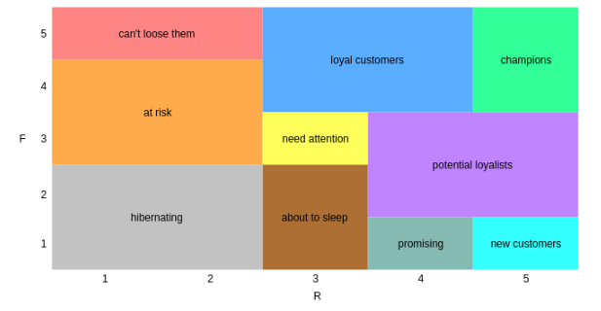
Recency: How recently a customer made a purchase
Frequency: How often a customer makes a purchase within a give time frame
Monetary: How much money a customer spends during their purchases
Basket size: The total number of items purchased divided by the number of transactions.
Tenure: The time difference between the customer’s first purchase and the present day
Support: Proportion of transactions in a dataset that contain a specific item or itemset.
Lift: Support Rate in Baseline Group divided by Support Rate in Target Group
Frequency score 1-5 (F): More frequent a customer buys, the higher the score
Recency score 1-5 (R): Reflects how recently a customer made a purchase. More recent a purchase, the higher the score
RF Score: Combines Recency and Frequency scores
For example : Frequency score: 3 Recency score: 1
FR score: 31 – At Risk

Slide 3
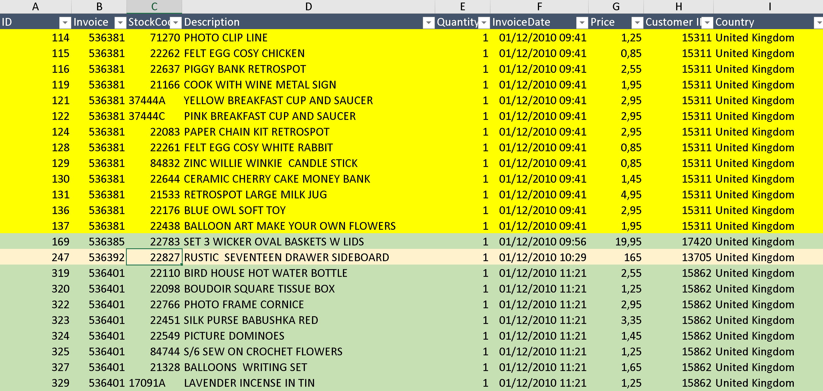
Task 1: Create a bundle for buyers of “Jam Making Set with Jars” and create a story for marketing
Task 2: Locate customers that buy “Jam Making Set with Jars” and have tenure more than 200 days and recency more than 60 days. Analyze this segment and suggest targeted offers.
Data overlook

Slide 4
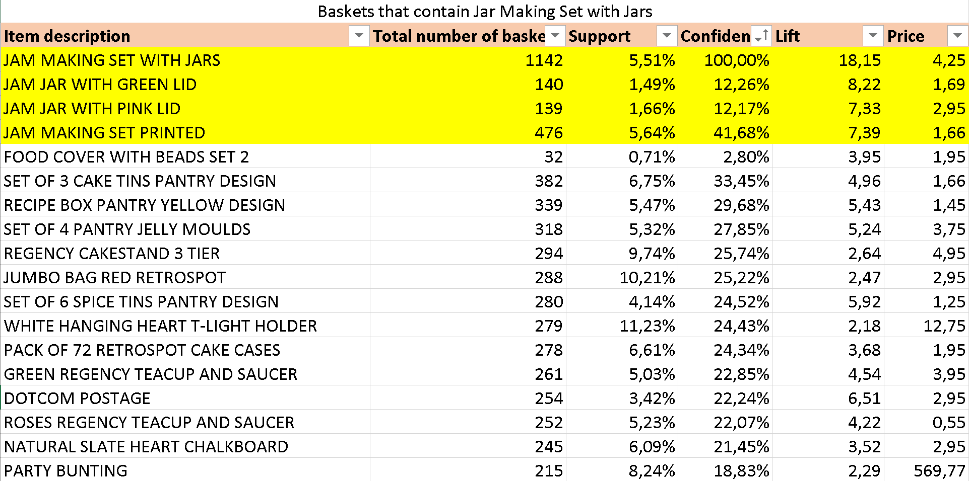
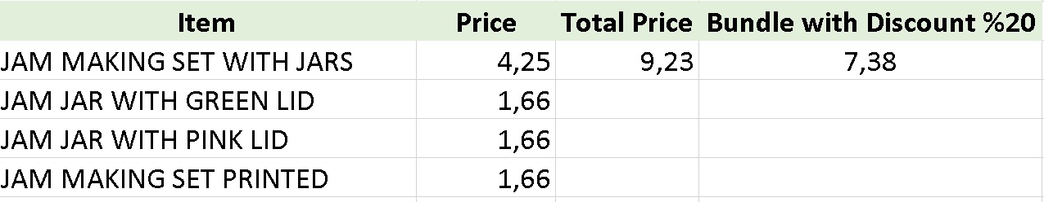

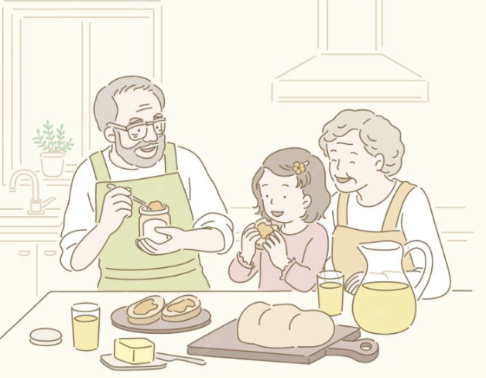
TASK 1
Step 1: Find the baskets that only contain “Jam Making Set with Jars”
Step 2: Find items that can be combined and has significantly high Lift and was relatively sold less.
Step 3: Create a bundle with at least 3 items and offer beneficial offer to the customer
Kenji and Yuki can make jam with their grandchildren and store them in their own personal jars with distinctive colored lids.

Slide 5
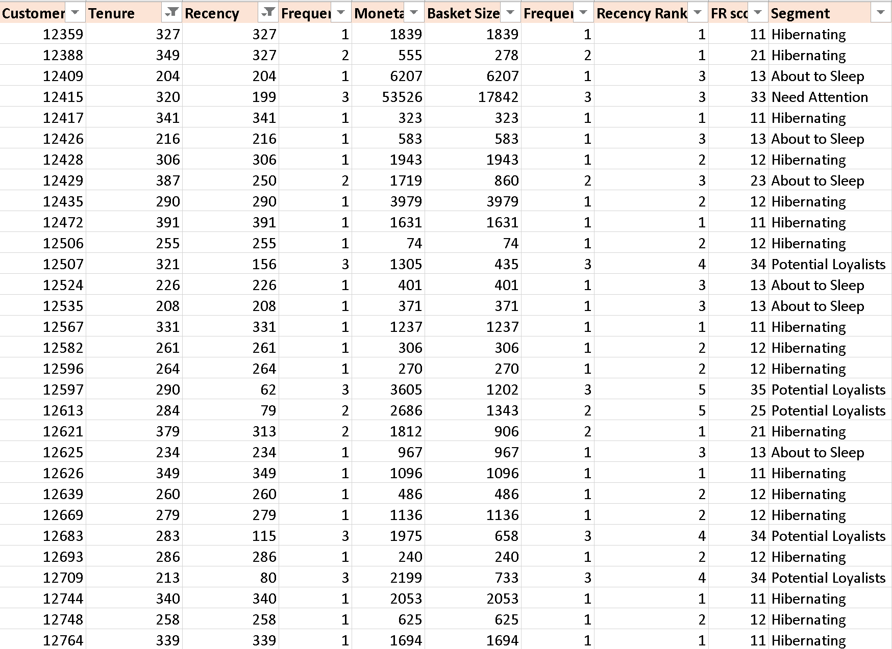
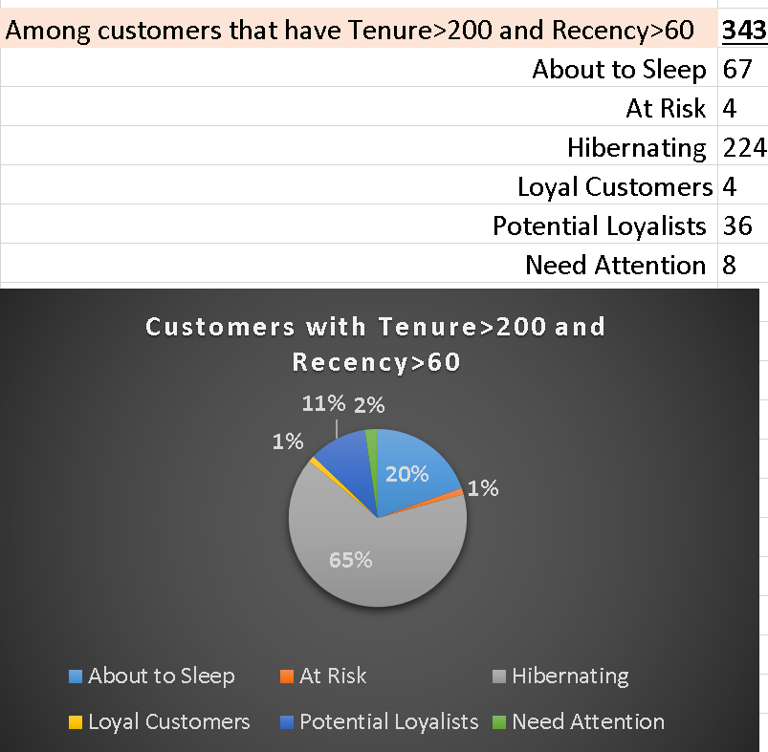
TASK 2
Step 1: Locate the baskets that contain “Jam Making Set with Jars”
Step 2: Calculate frequency, recency and assign frequency, recency scores
Step 3: Locate Segments
Step 4: Filter for customers that have Tenure more than 200 days and Recency more than 60 days.
Step 5: Recommend Strategies for this segment
'Win-back' email campaigns: We all receive time to time 'We Miss You' mails. Company can create bundles with special offers.
'Loyalty program re-engagement: Offer double points for next purchase within a timeframe
Limited time offers: If there is a holiday coming up a bundle or a promotion can be offered with a theme. Furthermore time-sensitive offers that are beneficial than usual purchase can be offered to create sense of urgency.
Reminder of past purchases: Based on past purchases suggestions or special offers for complementary products.

